Slide 1
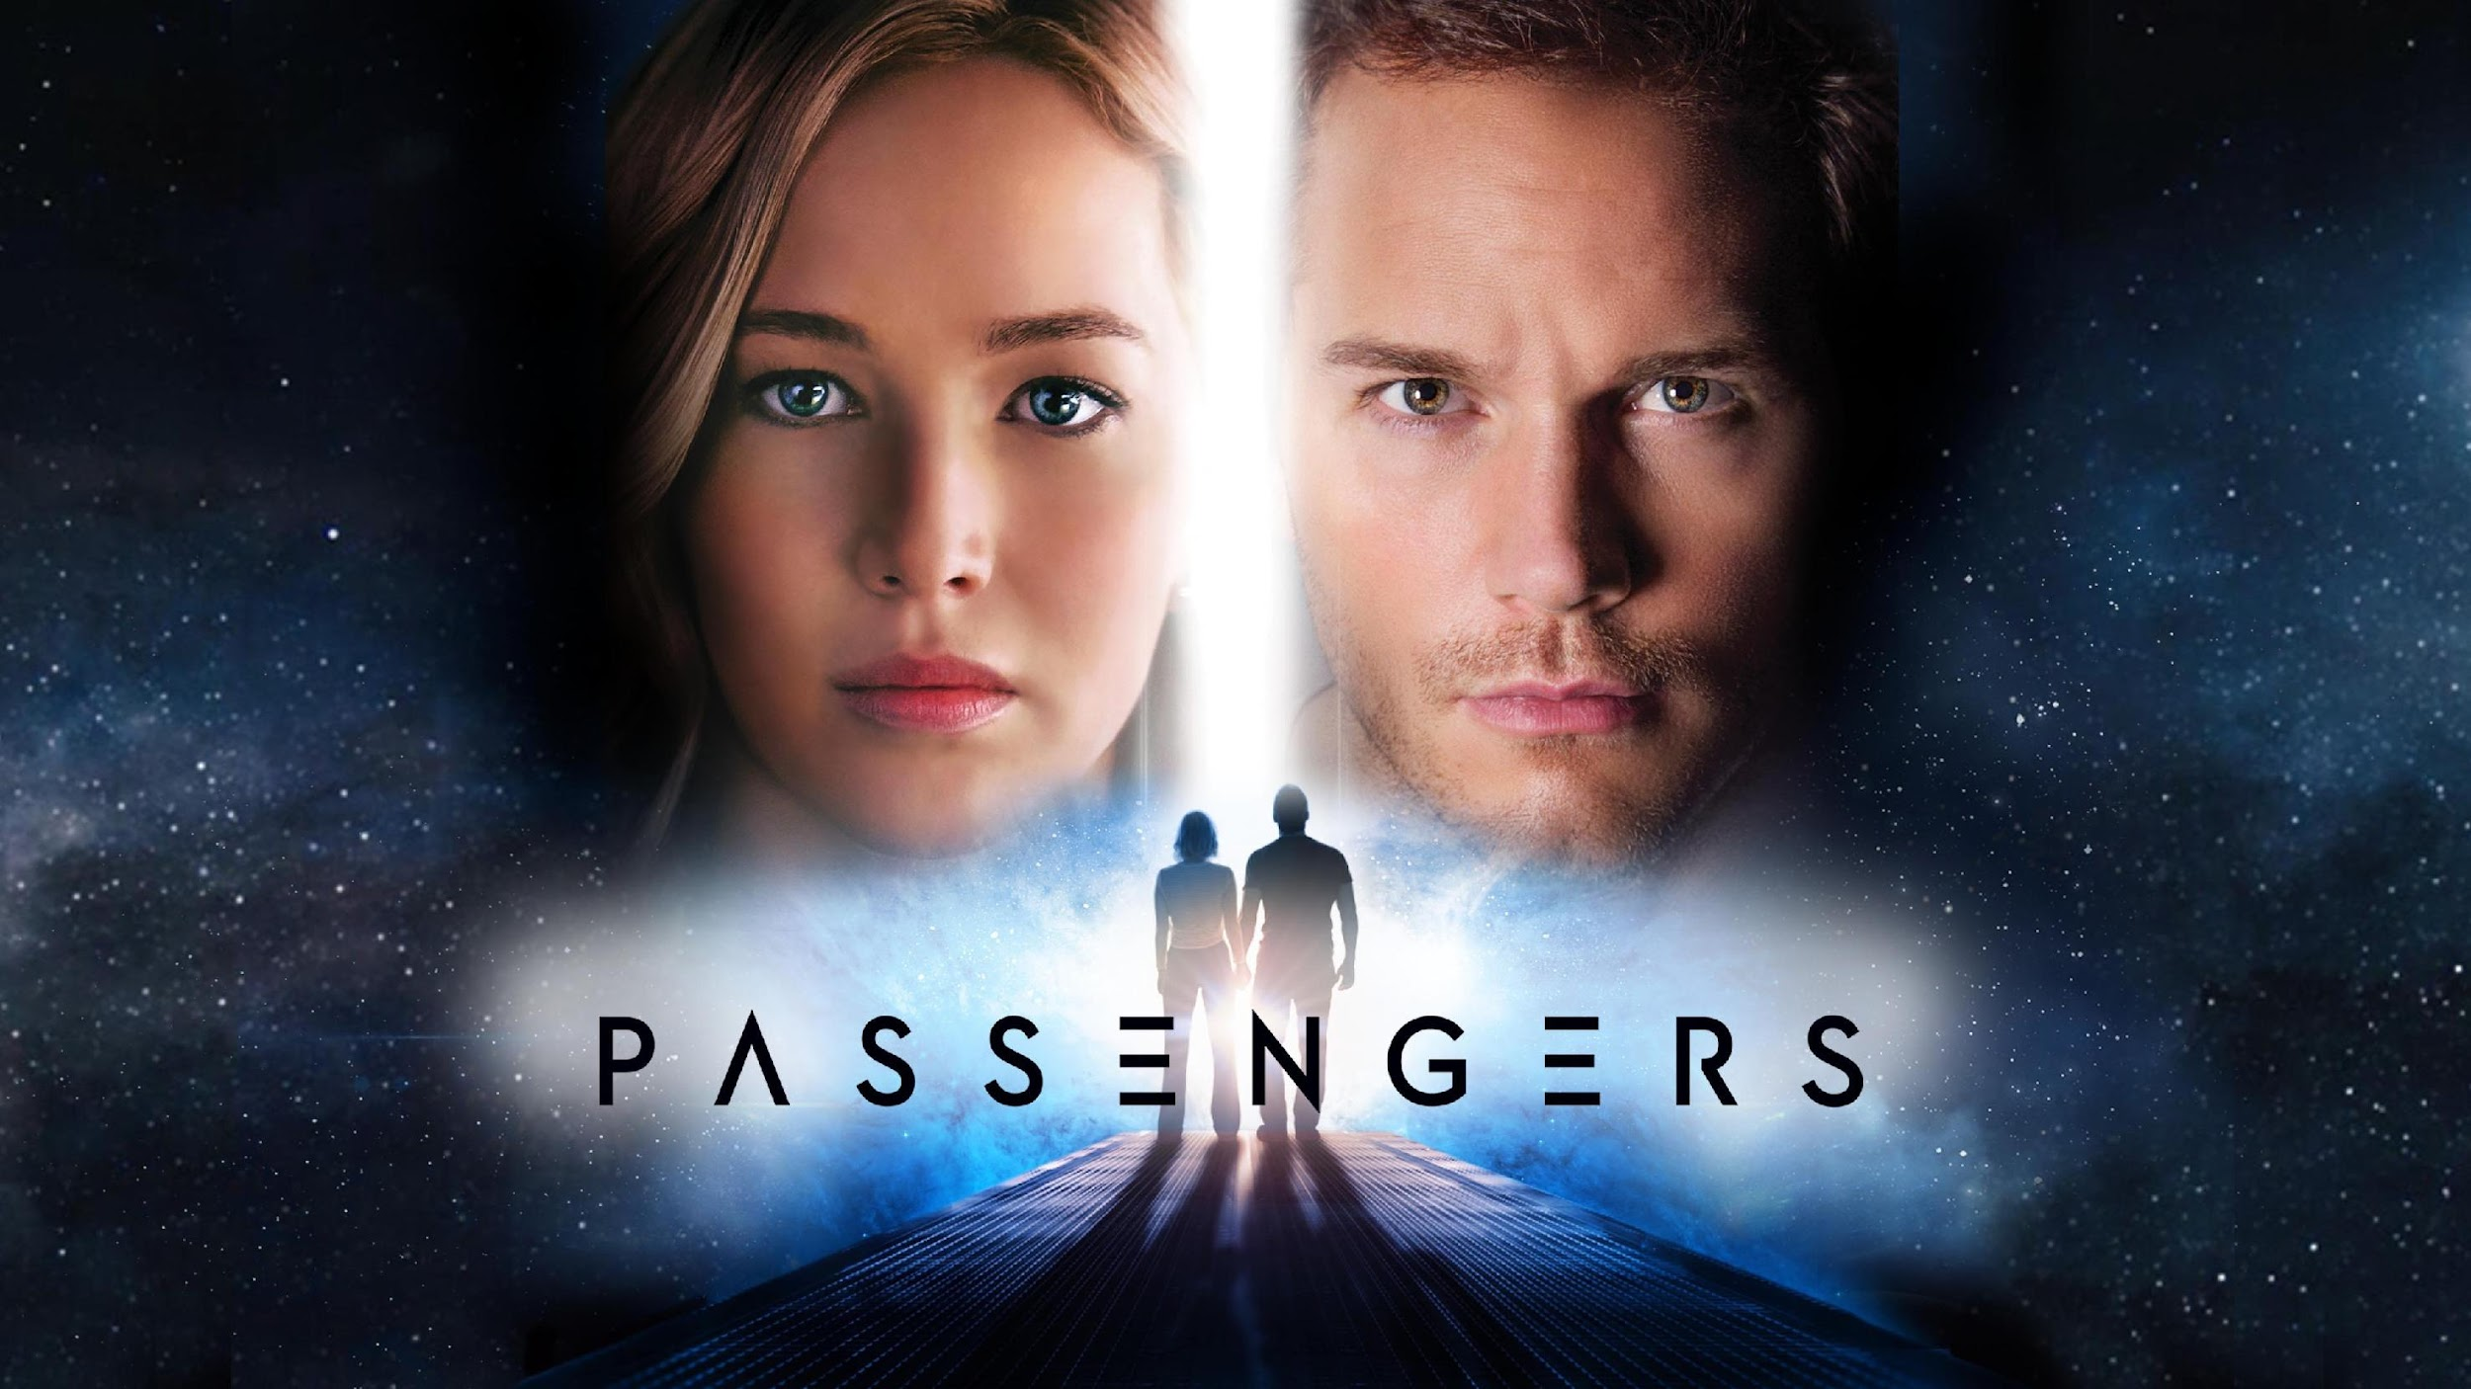
[17]
Passengers
Alex Li, Zackary Perry, Vaansh Mansharamani, Simon Tong
Notes:
Script: Introduce the movie (Hi everyone, this is Passengers (2016) Conclusions of the movie)
Introduce the names of presenters if necessary
Passengers is a movie where two ordinary passengers have to prevent a starship’s destruction in order to save the lives of thousands who are sleeping within it.

Slide 2
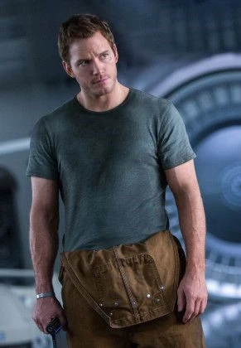
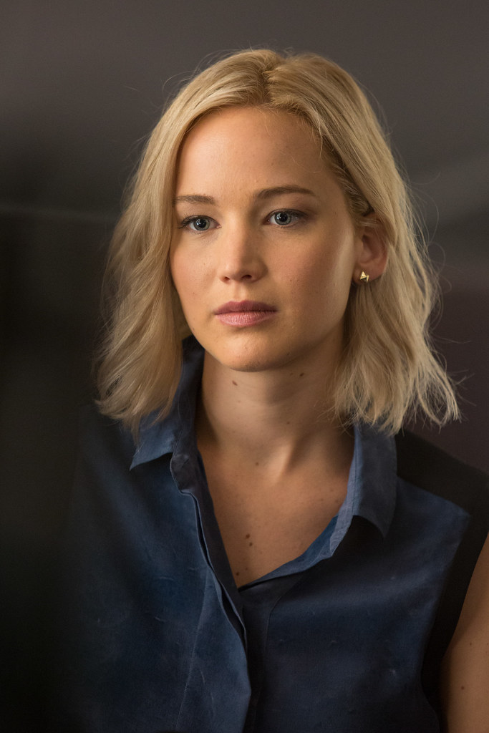
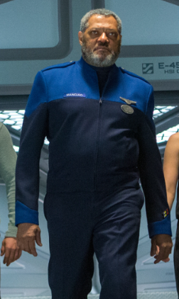
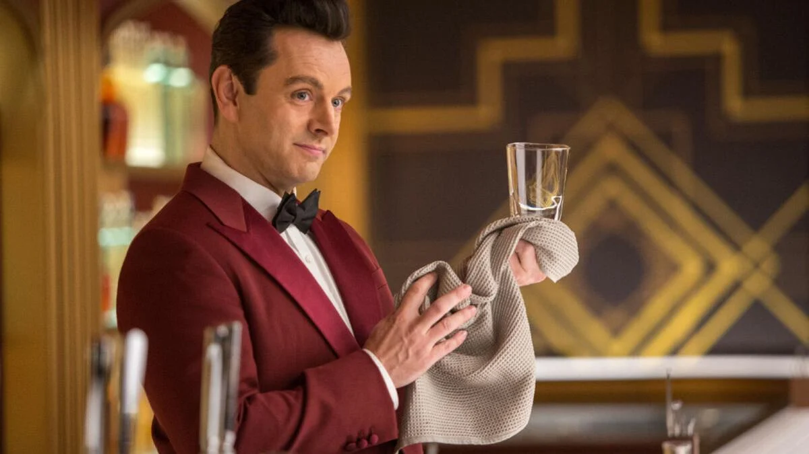
Characters
[2]
[3]
[1]
[19]
Arthur (*robot bartender who tends the bar)
Gus Mancuso (a deck crew manager)
Jim Preston (mechanic who wakes up first)
Aurora Lane (reporter woken up by Jim)
*”Android, technically.”
Notes:
ZACK SLIDE
Jim: A mechanical engineer back on earth, was travelling across space to reach a new and still blossoming society on the planet of Homestead II. Was awoken by a hibernation pod malfunction
Aurora: A writer from New York City, travelling to Homestead 2 to spend a year and return to earth to report on the experience. Was awoken prematurely by Jim
Gus: A Deck Chief of the Avalon, was awoken due to a hibernation pod malfunction. His crew ID gave Jim and Aurora access to parts of the ship they didn’t have access to for 2 years
Arthur: The Avalon’s android bartender, serves as an outlet for Jim and Aurora to vent their fears, joys, and frustrations to. An absolute gentleman (most of the time)

Slide 3
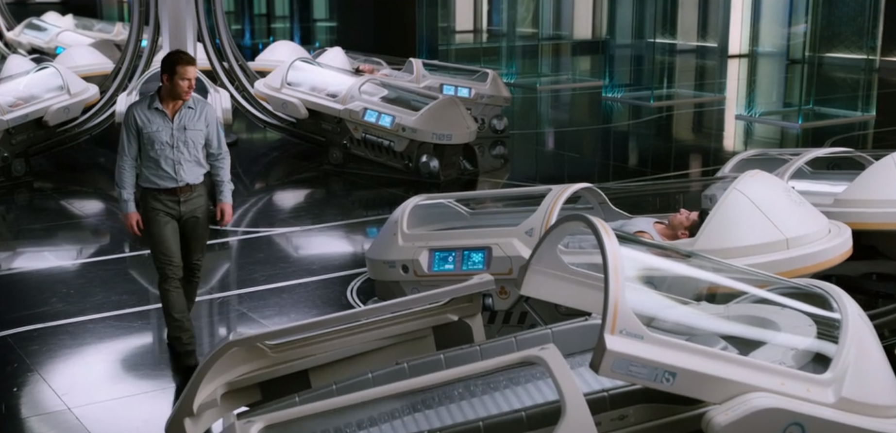
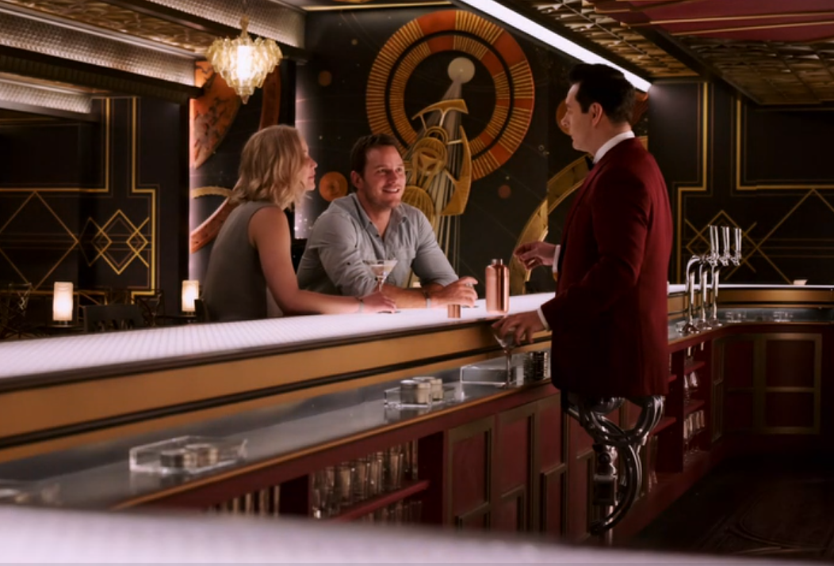
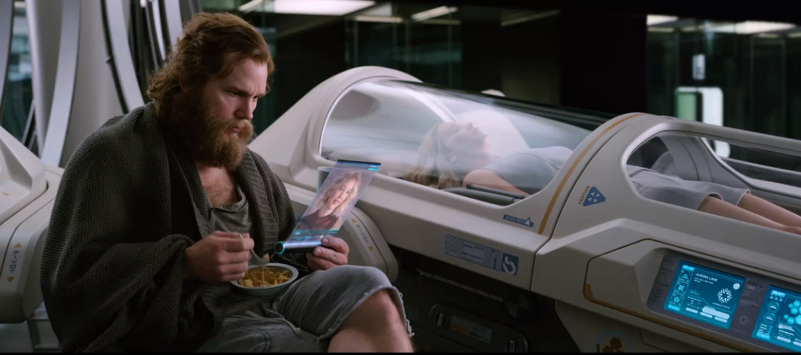
Plot Summary
[28]
[30]
Jim is the only human awake on the Starship Avalon
[29]
When he ends up going through with it, the two develop a close bond. But Arthur reveals the truth
He struggles with waking Aurora after learning all about her
Notes:
ZACK SLIDE
Jim wakes up on the Starship Avalon 90 years too early. No other humans are awake, only artificial intelligence.
He tries to get access to help in any way he can but is unable to; his hibernation pod failure was the first to ever occur, so there is no solution for the ship to provide him with.
With it appearing that Jim will be stuck on the Avalon until the end of his life, he falls into depression.
But then he meets Aurora. She is still asleep when he first sees her, but he is able to learn more about her through videos and writings provided by the ship, and falls in love.
He tries to resist waking her up, but after a year of loneliness he succumbs, tampering with her hibernation pod.
It takes time for Aurora to get used to her situation in the same way Jim had to get used to his. But they eventually get used to living life on the Avalon and develop an intimate relationship.
This peace doesn’t last forever, however, A year passes without Jim telling Aurora the truth of how she woke up; she thought it was an accident.

Slide 4
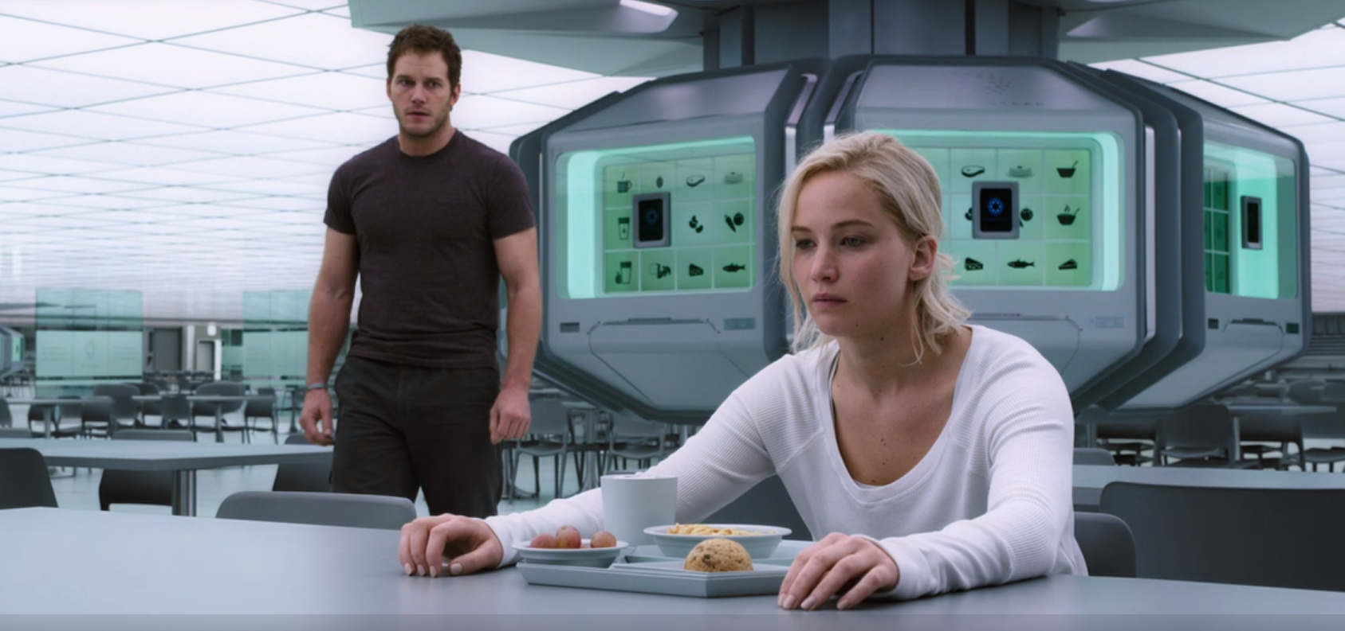
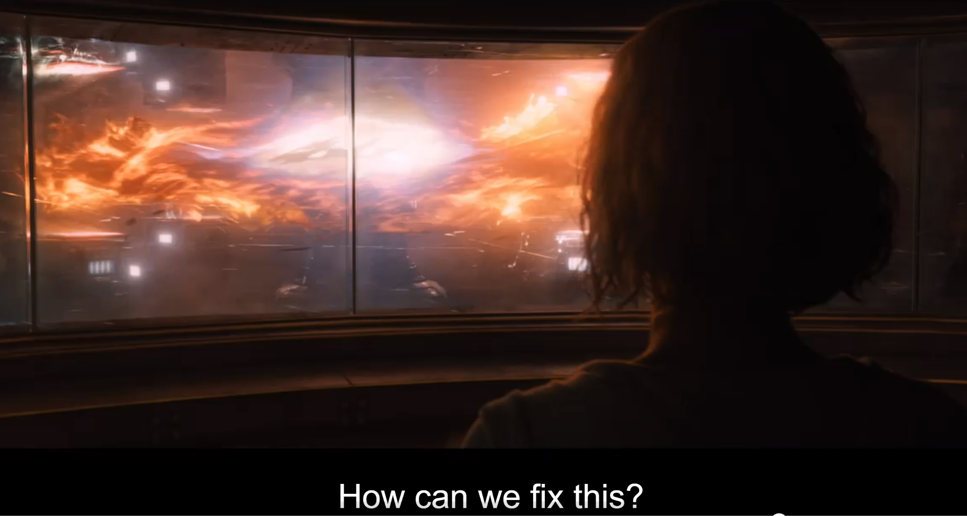
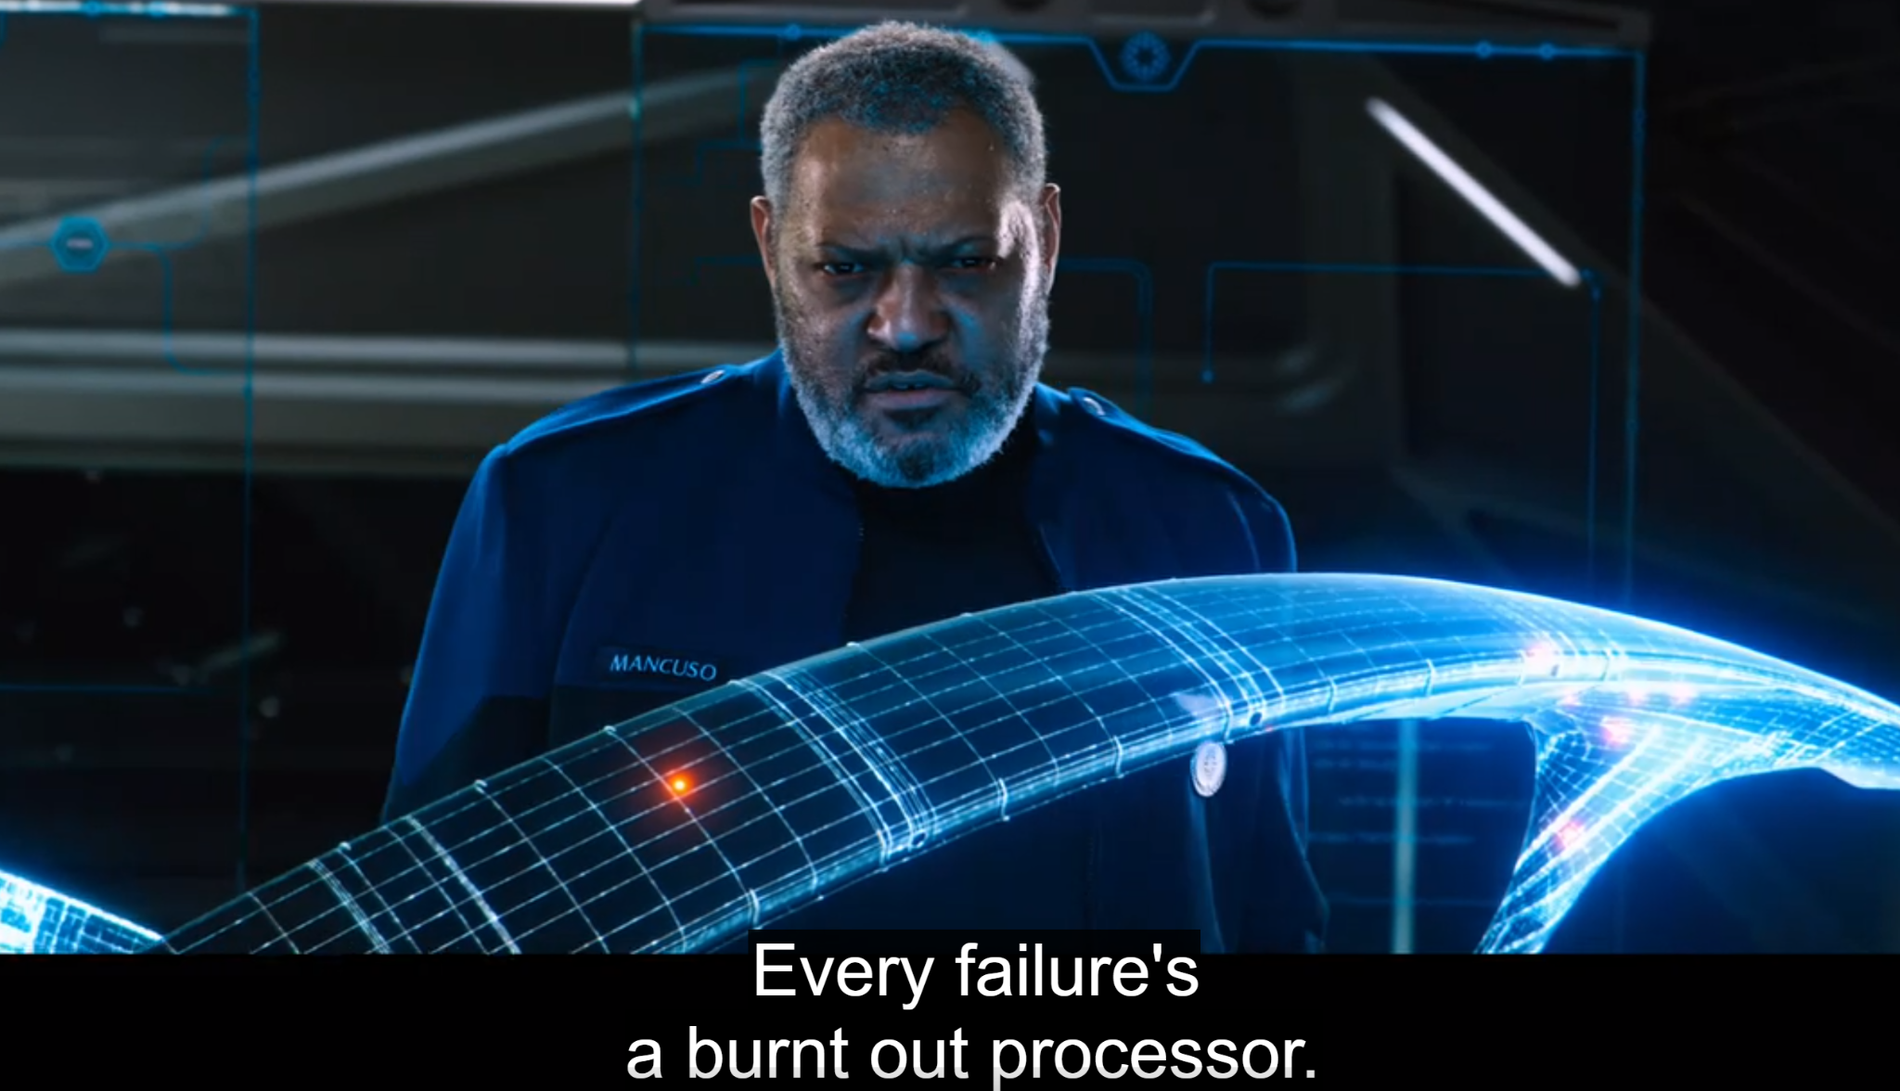
Plot Summary
[33]
[31]
A rift forms between Jim and Aurora. Meanwhile, Gus awakes as problems on the ship become more apparent
[32]
He passes away before he is able to find the source of the issue. With his ID, Jim and Aurora discover a broken fusion reactor computer. In a dramatic conclusion, they fix it, saving the ship and its passengers
Notes:
ZACK SLIDE
He did tell this secret to Arthur, though; after all, when Jim was alone, he found companionship in Arthur. But this resulted in a miscommunication, and Arthur telling Aurora the truth.
Meanwhile, in the two years that they’ve been living on the Avalon, an increasing amount of problems have gone wrong with it.
One of the errors is that a Gus gets awoken. He immediately suspects that something is wrong with the ship, but is unable to figure out what, as he starts suffering from organ failure and dies.
With his crew ID, however, Jim and Aurora are able to find the root of the problem; a meteor crashed into the fusion reactor computer.
Jim is able to insert a replacement computer, but the reactor still isn’t getting vented. He heads to the exterior of the ship and opens the vent from the outside in a near death experience.
Aurora saves his life using a device called the Autodoc. The two reconcile and live the rest of their lives out on the Avalon together.

Slide 5
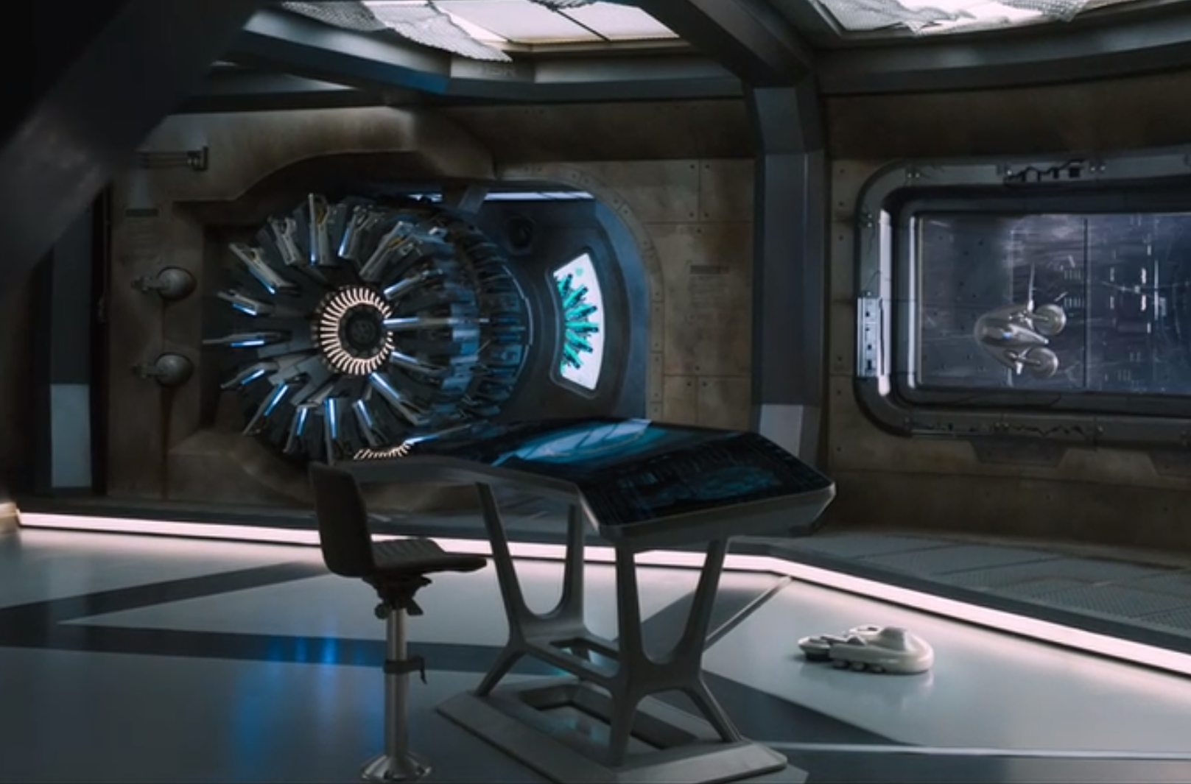
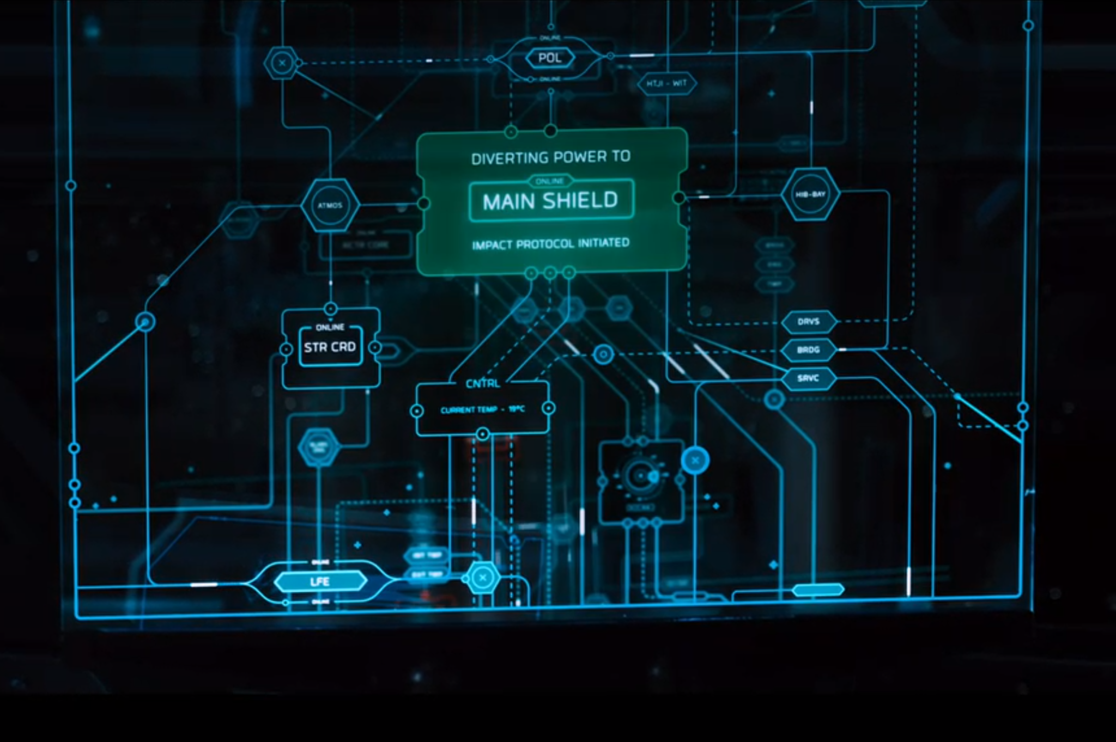
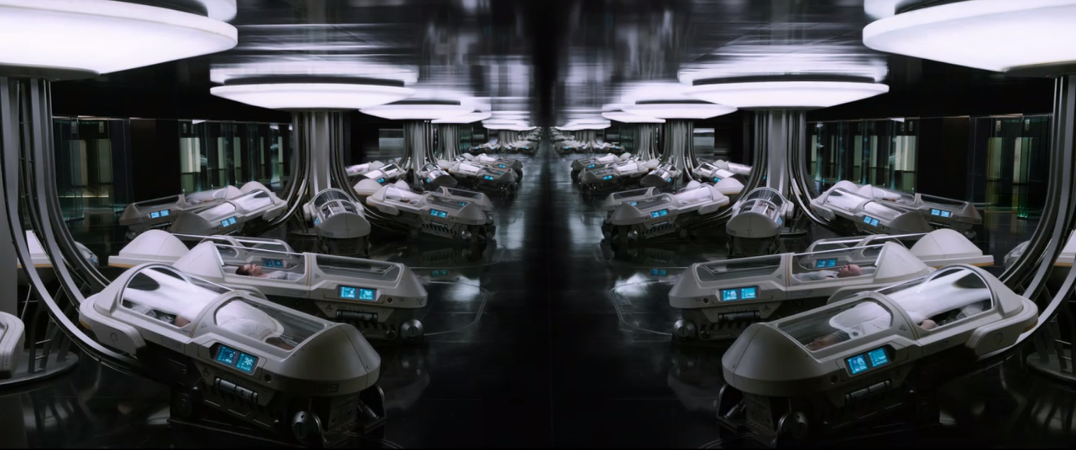
Computing Technologies
[34]
The fusion reactor computer, in a fully repaired state
The autopilot performing one of its tasks of transferring energy to the shield of the ship
[35]
The hibernation pods of the passengers on the Avalon; the ones featured are operating properly
[36]
Notes:
ZACK SLIDE
Fusion Reactor Computer: The source of Passenger’s main conflict. Its job is to autonomously cool down the reactor of the Avalon, so that it doesn’t overheat and combust.
Autopilot: Keeps the Avalon running autonomously by navigating the ship from Earth to Homestead II. In the event of errors on the ship, it will also delegate tasks to other computers until the error becomes resolved. Hibernation Pods: The devices responsible for keeping the passengers and the crew of the Avalon in a state of hibernation, where their metabolic activity halts until 120 years pass and they arrive at Homestead II. Jim’s malfunctioned when the clock chip on his hibernation pod burnt out.

Slide 6
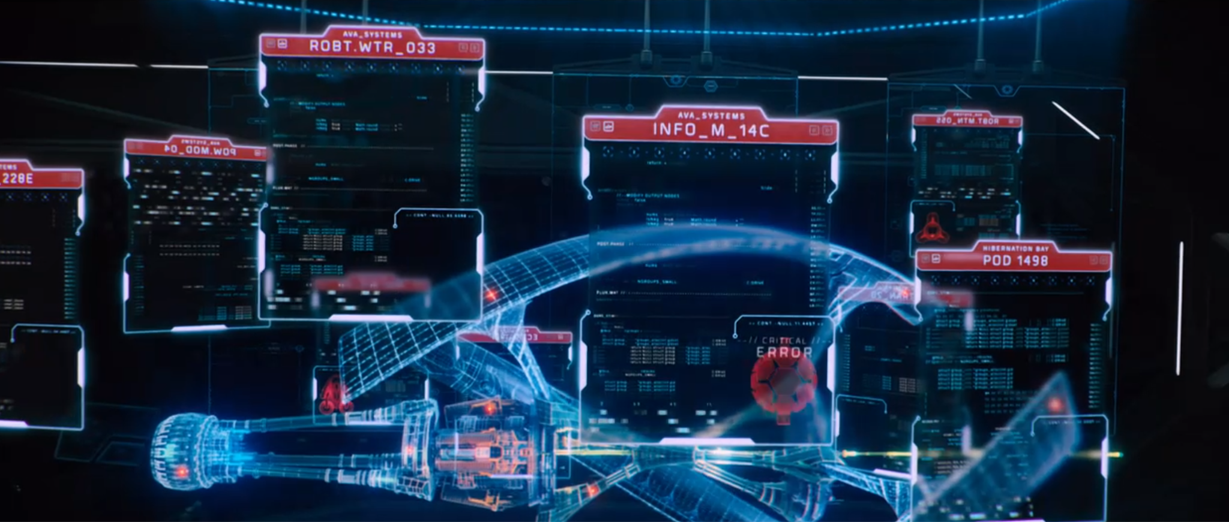
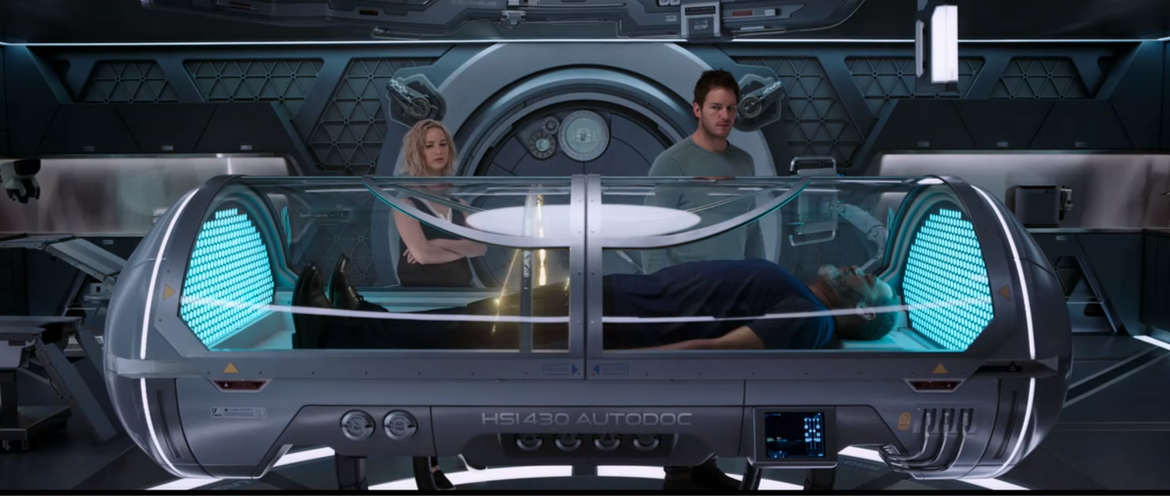
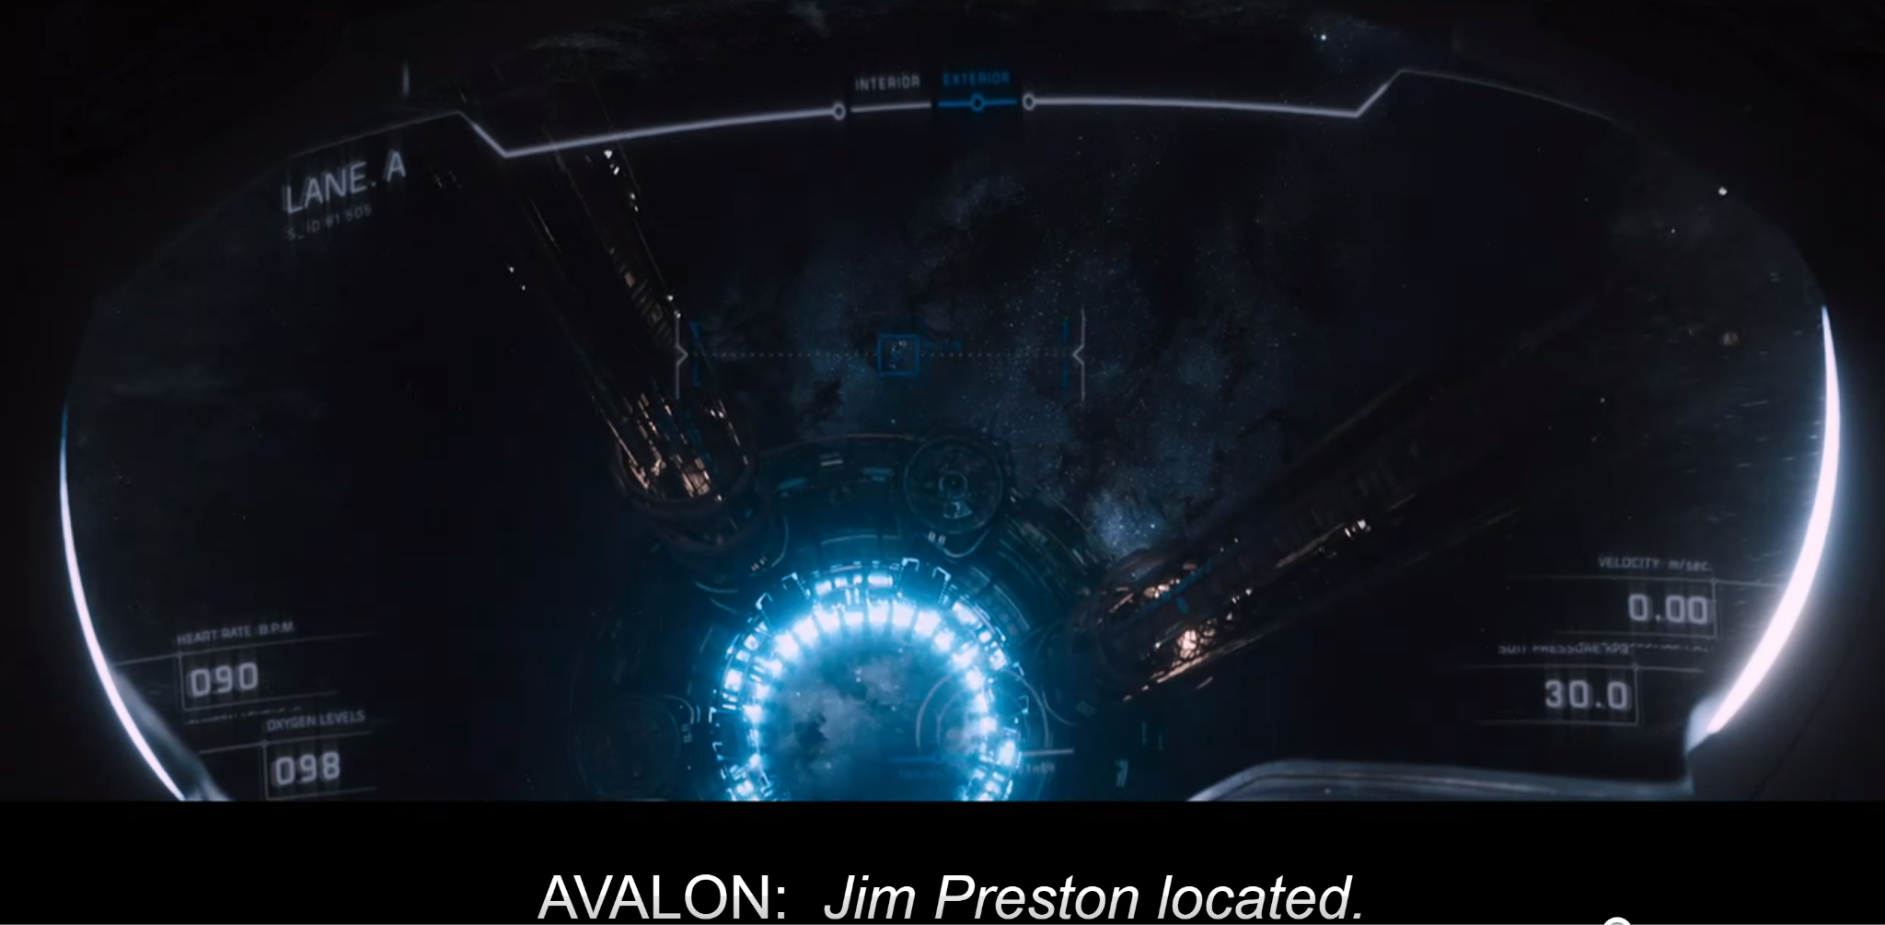
Computing Technologies
[38]
[39]
The diagnostics system displaying errors across the Avalon before it too malfunctioned
[37]
The autodoc scanning Gus; this was one of the features of the device, on top of its abilities to stop all metabolic activity and perform postmortem operations. These features, however, required special authorization
The spacesuits’ tracking feature allowed for Aurora to locate and save Jim
Notes:
ZACK SLIDE
Autodoc: A device that is able to scan a patient and list out a diagnosis; this was how Gus was able to find out about his 612 disorders. In command mode, the autodoc has extra features, such as halting metabolic activity and resuscitations capabilities. This was used on Jim by Aurora.
Diagnostics System: Job is to receive errors and list them all out collectively for either the autopilot to handle or the crew of the Avalon. Caused trouble for Jim, Aurora, and Gus when it itself failed, and thus was unable to display any of the errors existing on the Avalon. They had to find the problem manually.
Spacesuits: The computing technology within the spacesuits on the ship helped Aurora with tracking and finding the location of Jim as he was unconscious after saving the ship.

Slide 7
Conclusion 1
There needs to be sufficient redundancy measures in place on all computing systems to avoid detrimental scenarios.
Notes:
Script:
And our First Conclusion is There needs to be sufficient redundancy measures in place on all computing systems to avoid detrimental scenarios.

Slide 8
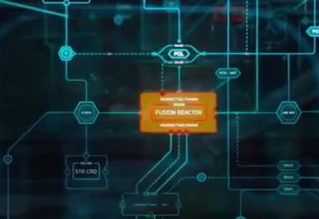
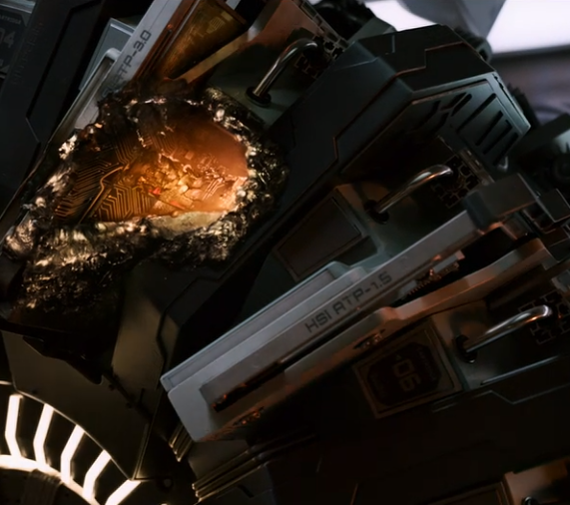
Reason 1 :The Fusion Reactor Computer
[5]
Fusion Reactor Computer controls the reactor within the ship
Is destroyed by meteor, no sufficient backup plan to repair it
Problem was a hardware related issue, needed to be repaired by a human
[4]
Notes:
SIMON SLIDE
The fusion reactor is the cause of danger in the movie. Because it is destroyed by a meteor, this results in a physical problem on the ship that an automated software cannot solve.
Because of this, the reactor almost overheated and the entire Avalon nearly exploded. Despite this possibility, no redundancy plans were implemented. For example, despite all the robots on the ship, none existed to perform a task like this.

Slide 9
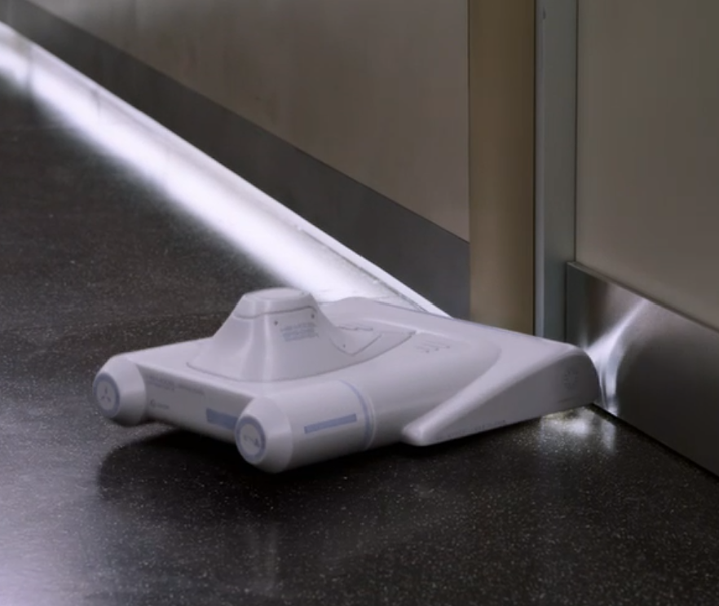
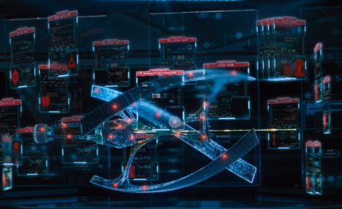
Reason 2: The Backup Plan
The backup plan for the ship was to distribute the job of the fusion reactor computer to control functions of the ship
“Everything on board’s thinking too hard,” resulting in burnt out processors
Put so much confidence in the ship, it didn’t even consider an alternative if something were to happen to it
[21]
[22]
Notes:
SIMON SLIDE
Instead, this was the ship’s plan: using its autopilot, it delegated the job of the fusion reactor computer to other computers on the ship. On paper, this could have been a useful practice. But on its own, this sort of “backup plan” was not a good long term solution.
It goes to show how much faith was put into the Avalon and all of its software components. There was trust that if something were to go wrong in the 120 years that the ship was traveling, the autopilot will be able to solve it without human input. We can’t even trust the Starship food delivery robots to always make a campus length delivery without fail.

Slide 10
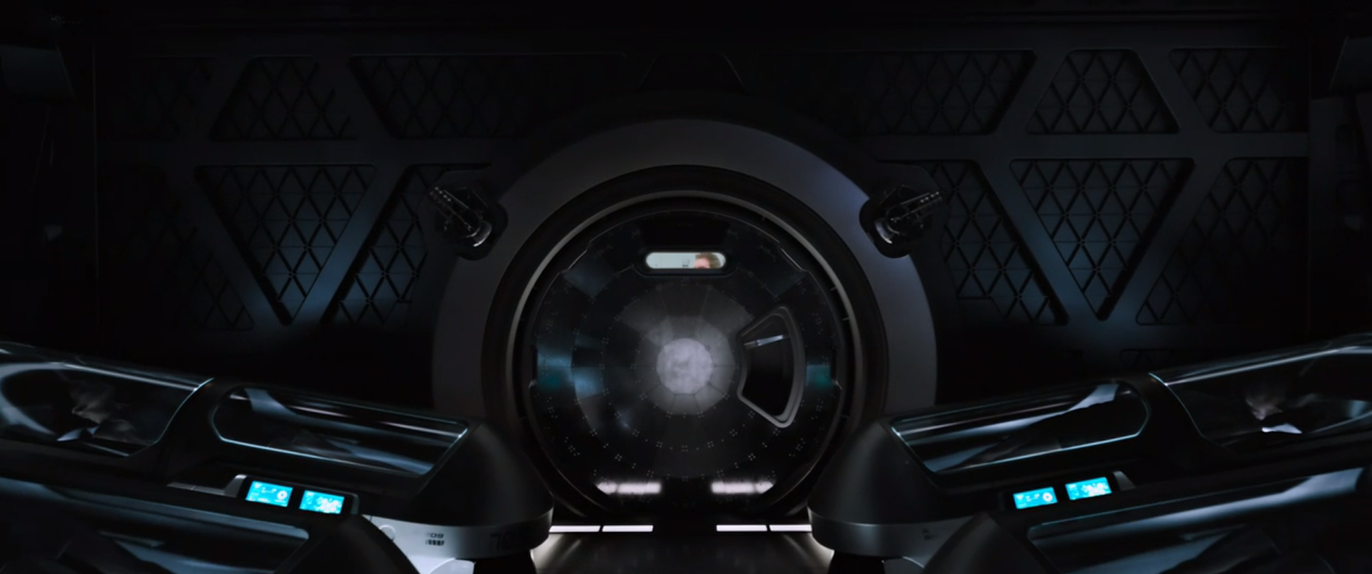
Reason 3: No systems to awake the crew members to look at failures within the ship
Crew is placed in hibernation pods with no way to wake them up, fully relying on Autopilot system to pilot the ship.
Ethically wrong. What if ship gets destroyed? Who is responsible?
[15]
Notes:
The 3rd reason is the crew compartment was blocked by huge iron door which Jim tried multiple times to break in and wake up someone to help him, this is a clear redundancy problem
there is no way for people without crew id to enter this room and wake up crew members in time of emergency.
In this case, what if an emergency occurred and someone needs help while all the crew was sleeping, whose responsibility should it be?
SIMON SLIDE

Slide 11
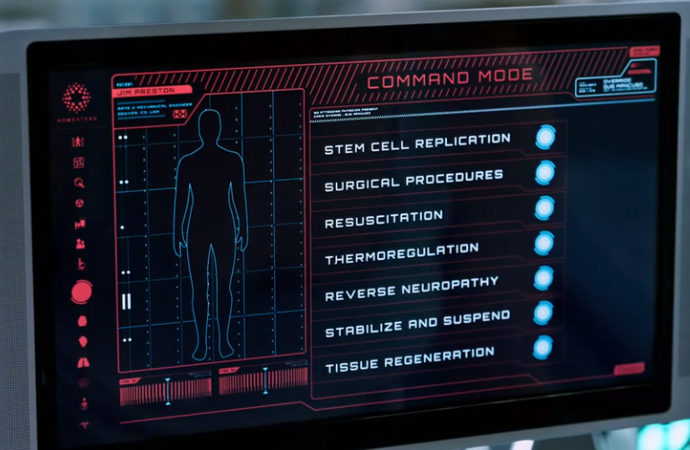
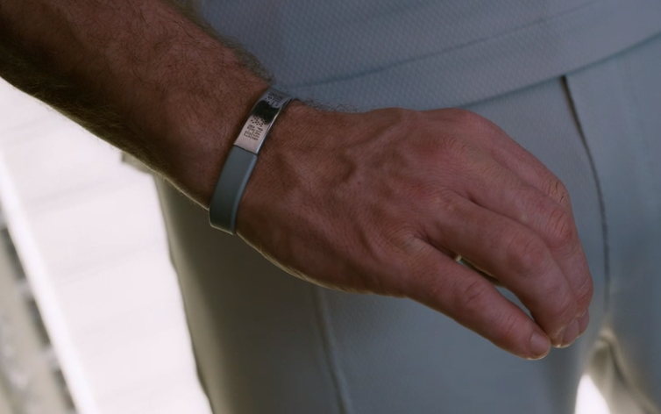
Reason 4: Autodoc & ID
[16]
Autodoc requires ID of a Crew Member to perform advanced commands
The ID of all Passengers controls all their privileges on the ship.
Ethically Inconsiderate, considering emergency
[17]
Notes:
The forth example is that there is only one autodoc on the ship for three thousand passengers on board.
but in order to use this autodoc it needs a crew members ID to perform its advanced feature
This leads to a problem shown in the movie, where Aurora was trying to save Jim's life by illegally using Gus's ID, which he gives to her before he dies. this also leads to another problem, where the ID is used to access almost everything on the ship, including basic needs like room access and requesting food.
So, if a user’s ID was broken,and there is no way to fix it, then that person will probably have no food to eat for the rest of the voyage.
SIMON SLIDE

Slide 12
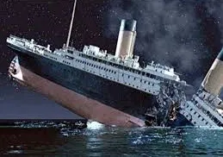
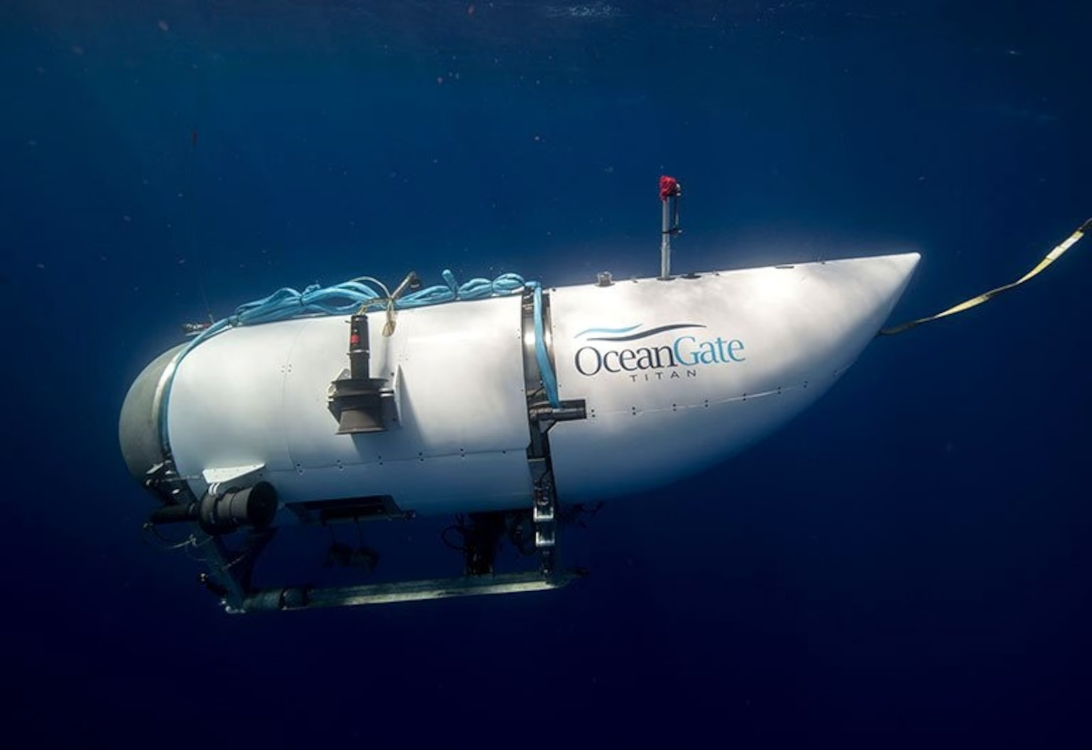
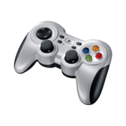
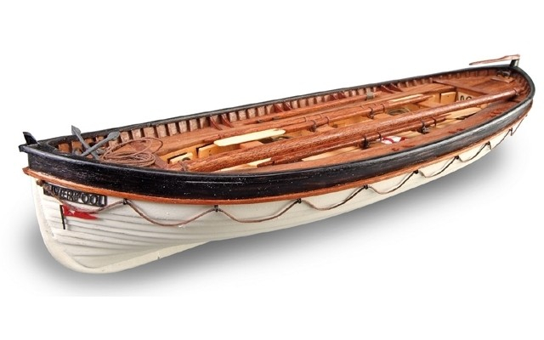
Reason 5: Real life Parallels of Lack of Redundancy
- Ocean Gate Titan Submarine
-The Titanic [1517 people died]
[6]
[7]
[18]
[8]
Notes:
titanic two thirds death rate [40]
They believed the titanic was “practically unsinkable” [41]
They put a lot of faith in the titanic's engineering [42]
Stockton Rush put a lot of faith in his carbon fiber hull similar to how Avalon’s ship put too much faith in its shield [43]
Both the avalons autopilot, and the Stockton Rush overestimated the ships capabilities [44]

Slide 13
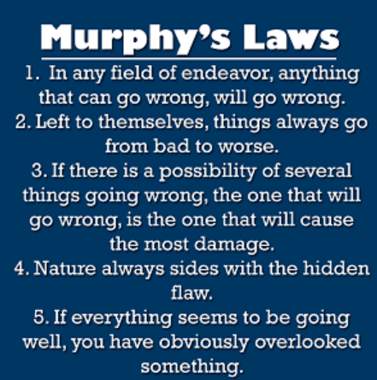
Murphy’s Laws Relating to FIlm
The ship’s reactor getting struck
Avalon overheating to try and fix the problem
Asteroid hitting specifically the ships fusion reactor
Nature = Asteroid
“They never malfunction” - Arthur
[27]
Notes:
The image on the left describes some of Murphys most important laws. These laws were broken throughout the movie, and our thought that was interesting. The law states that everything could go wrong will go wrong, and in term of the movie, it is about a star ship traveling through space, it is very possible that it has something goes wrong in its course. thats where nature comes in, in the movie the asteroid represents nature and hits the ship, which caused a chain of events that could lead to the destruction of the ship if Jim was not there to fix it.
VAANSH SLIDE

Slide 14
Conclusion 2
Emphasizing the importance of honesty regarding safety information is crucial, due to the significant negative impacts that misinformation can have.
Notes:
VAANSH PRESENT

Slide 15
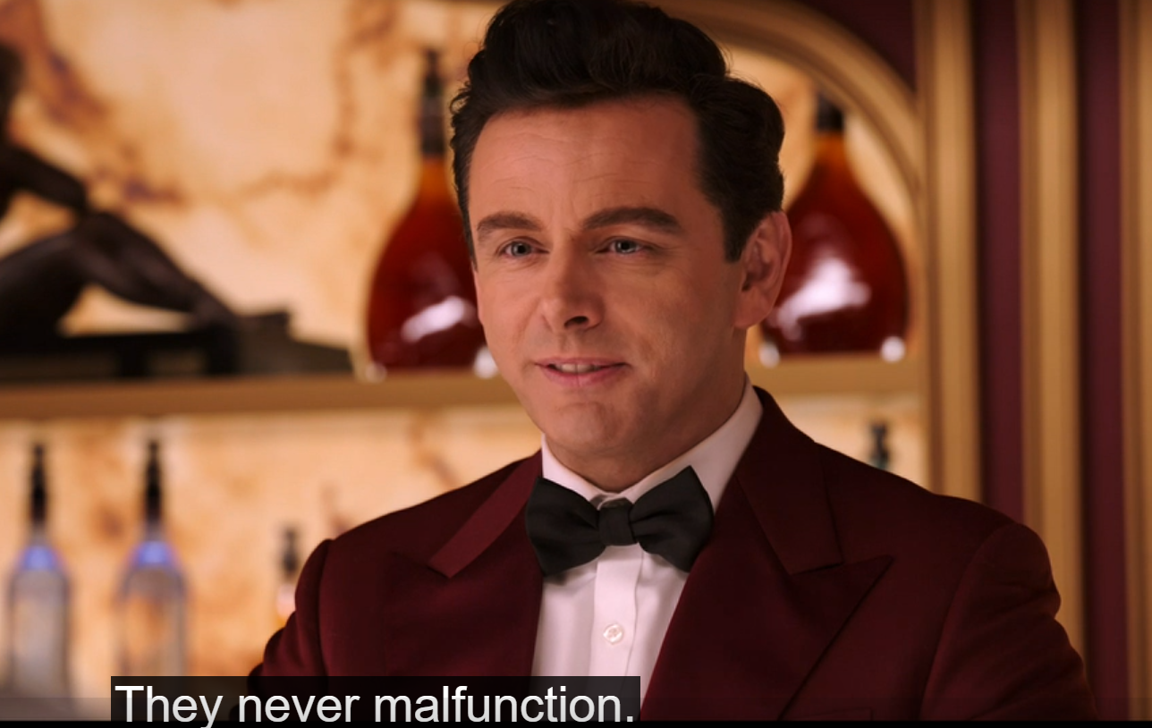
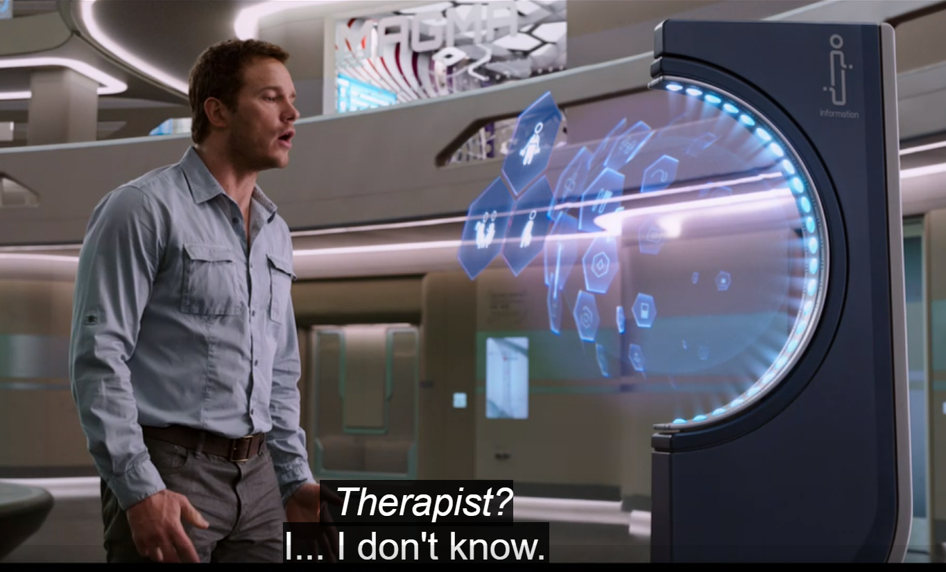
Reasons
Put image of the help desk here
[23]
[24]
Notes:
The false 100% safe advertising by the Homestead Company made it so that everyone believed it was safe, hence lack of redundancy measures(tie into previous conclusion), causing the condition on the ship.
The automated systems aboard the Avalon initially create an illusion of safety and convenience. However, this illusion is shattered when Jim discovers that critical information about the ship's condition has been concealed. This lack of transparency leads to a cascade of events that endanger not only Jim's life but also the lives of all passengers aboard. Therefore, the movie illustrates how honesty about safety information is essential to prevent potentially catastrophic outcomes and maintain trust in technological systems.
VAANSH SLIDE

Slide 16
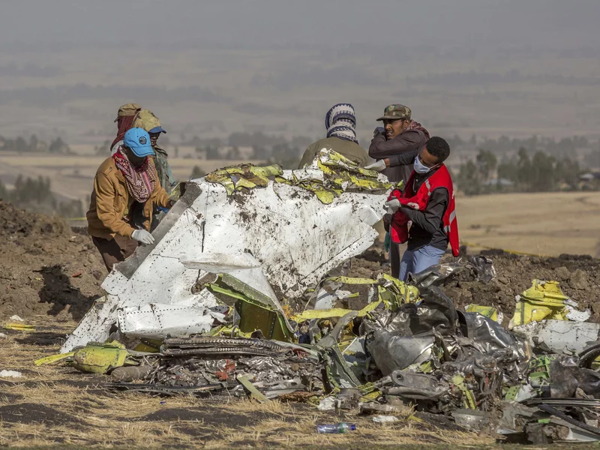
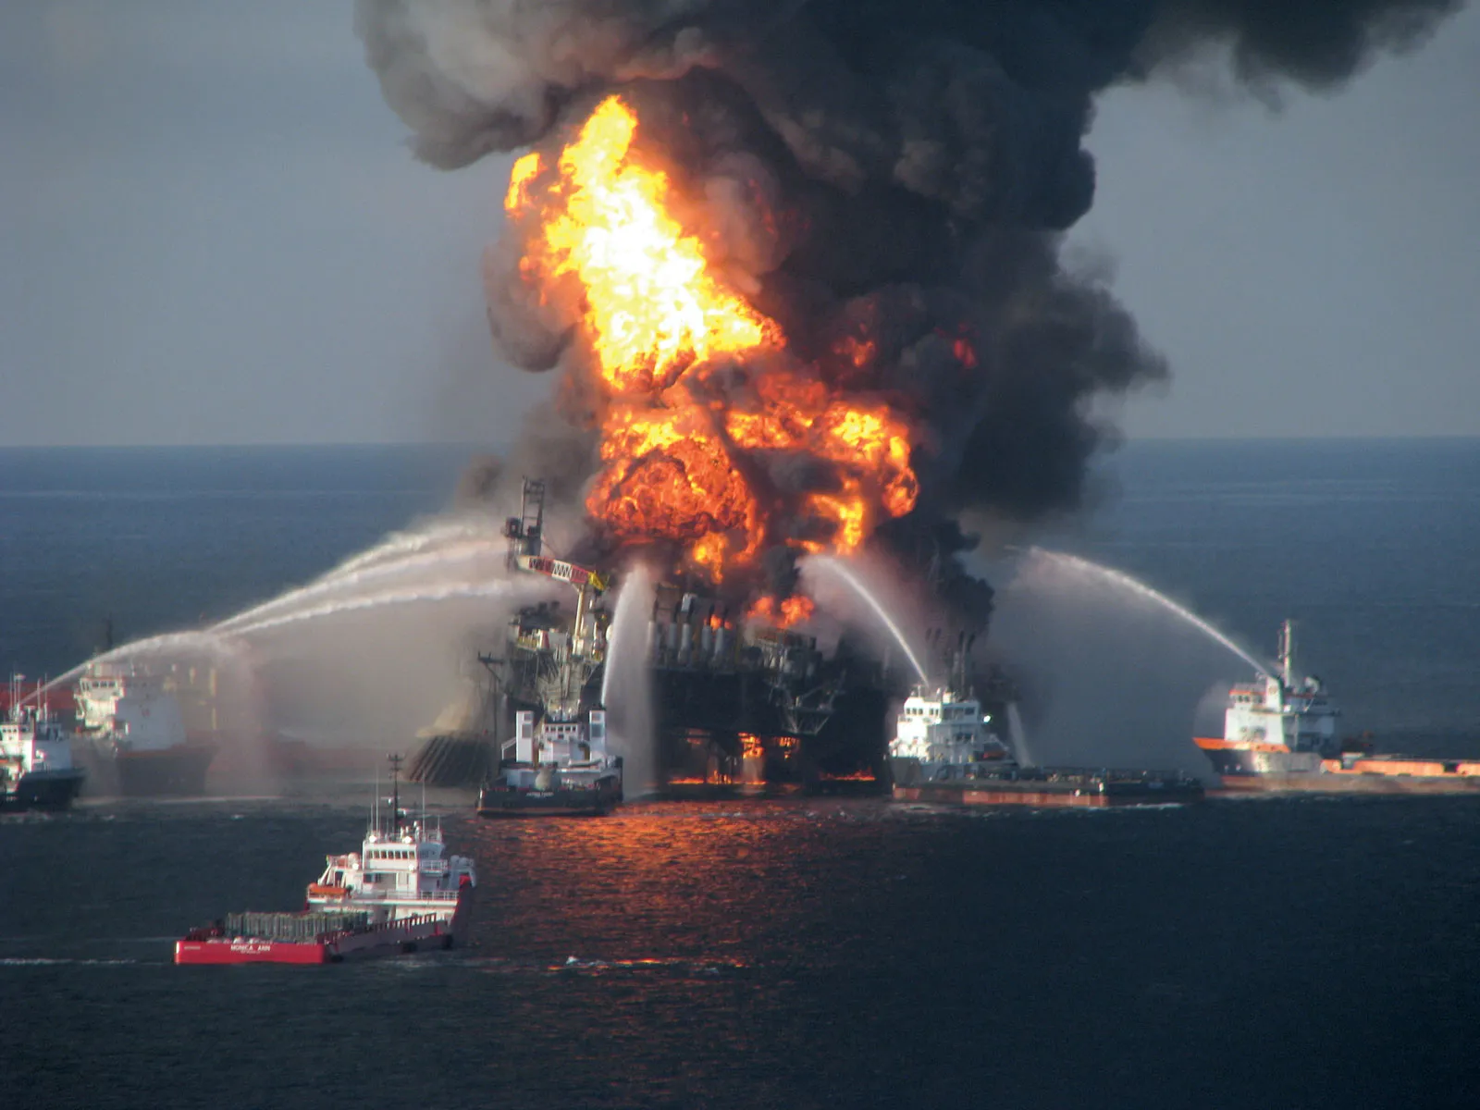
Real World Examples
The Boeing 737 MAX crash [11]
The Deepwater Horizon spill [13]
Notes:
Boeing: small aircraft, to match w/ competition it strapped a huge engine to it and use computer control panel to help this engine ‘fit’ the plane. And when the pilots were unable to control the small plane with such a huge engine, Boeing instead of saying that the engine was too big for the plae, or other technological failures, they blamed the pilots, causing more deaths in necessary, as if they admitted engines were too big, then those airplanes would stop flying or get fixed, preventing unnecessary deaths.[44]
When the Deepwater oil spill happened, the wells owner believed that there were no downsides associated with failure of the rig. This narcissism caused the deaths of 11 people.[14]
VAANSH SLIDE

Slide 17
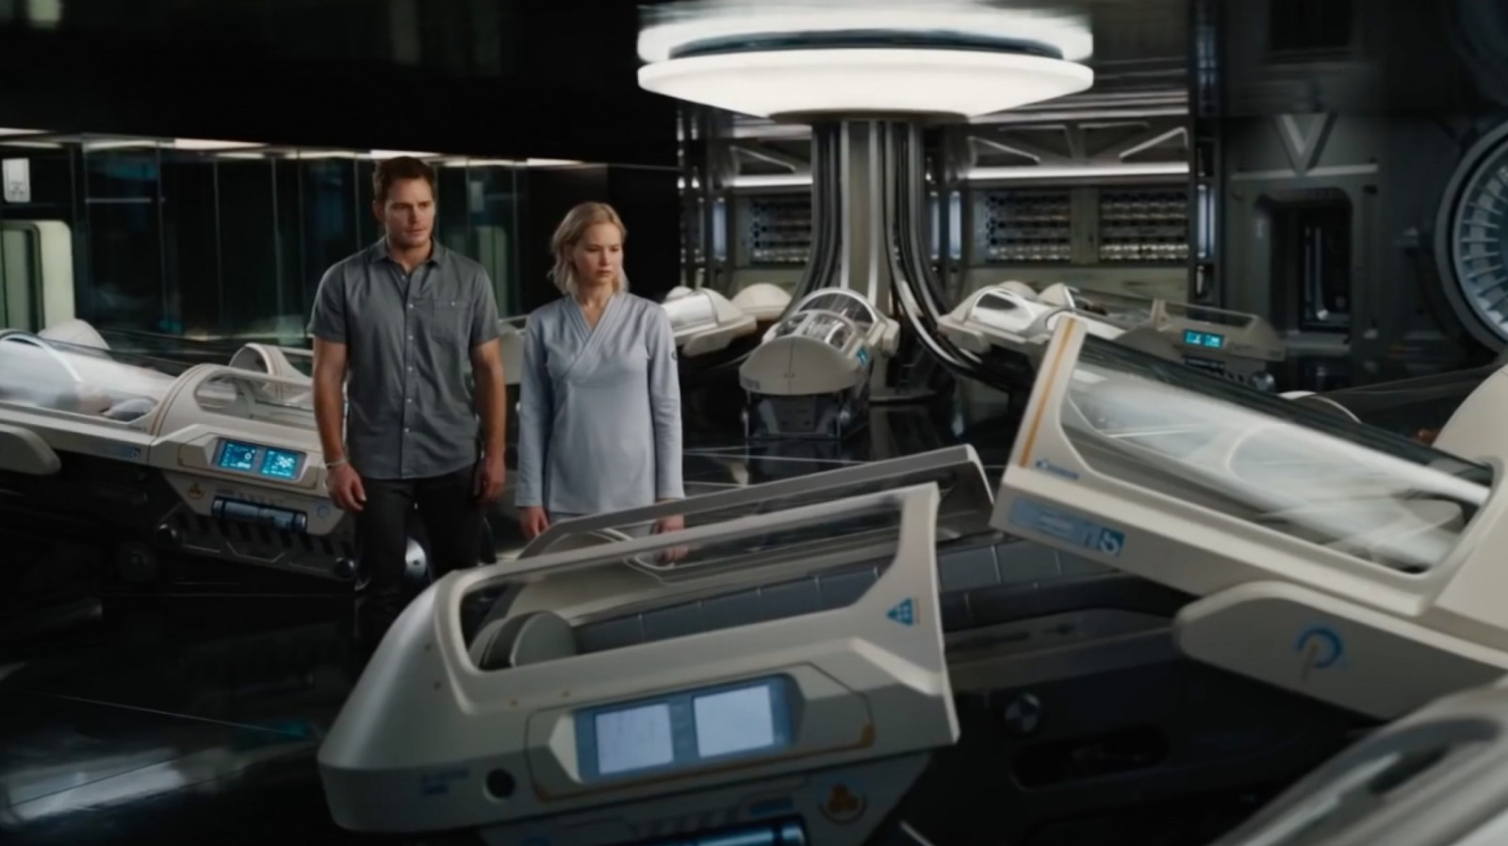
The Problem with - “100% Fail Safe”
“Absolute Certainty Is Not Scientific”
“There must be a way,”- Aurora when talking about going back to sleep in the pod
The Homestead Group advertised the Avalon is 100% safe, although it clearly isn’t
[9]
Notes:
Explain instance in the movie that is a argument for this conclusion. ‘THERE MUST BE A WAY” ALSO THE FALSE ADVERTISING OF HOMESTEAD saying the ship is failproof.
Is this slide too similar to the first slide for this conclusion?
VAANSH SLIDE

Slide 18
Conclusion 3
We should not be over reliant on Autopilot/AI systems for guidance of decision making.
Notes:
ALEX PRESENT
Script: Finally, Our third conclusion is We should not be over reliant on Autopilot/AI systems for guidance of decision making.

Slide 19
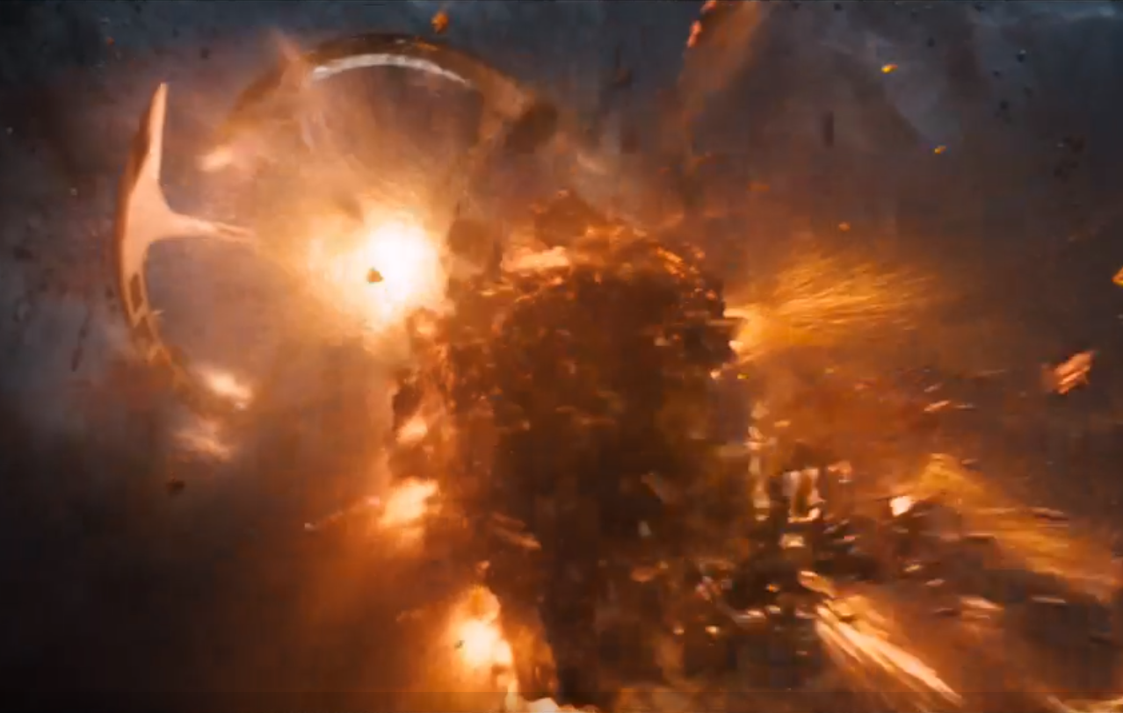
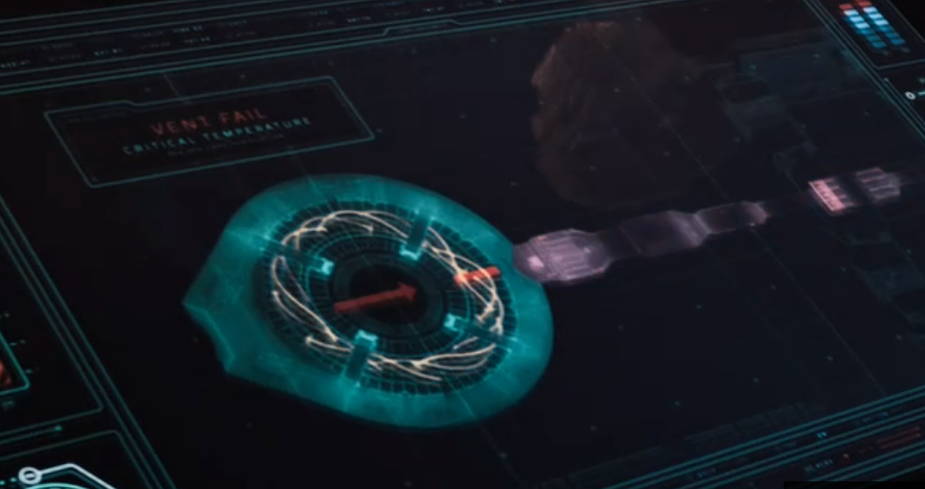
Reasons
[25]
[26]
The Ship was saved by People
Overstressing the system caused Overheating of the reactor core
Notes:
Script: A reason why we shouldn't be solely reliant on AI systems in key decision making is in the movie, we see that the starship Avalon was saved by People: Jim and Aurora, technically Gus as well since he gave them is ID which gave access to key regions of the ship, and allowed Jim and Aurora to save the ship. AND WAS not saved by AI SYSTEMS. We see this in Figure 25, which is the scene where Jim and Aurora successfully manually open up the vent, allowing the reactor core to cool down. Figure 26 is the image showing the reactor core overheating, which is caused from the lack of sufficient redundancy and due to the AI system not being able to solve the issue of the reactor core overheating. As such, these AI systems cannot be trusted in key decision making, as it would’ve just kept on piling on tasks to other computing technologies on the ship until everything fails.
ALEX SLIDE

Slide 20
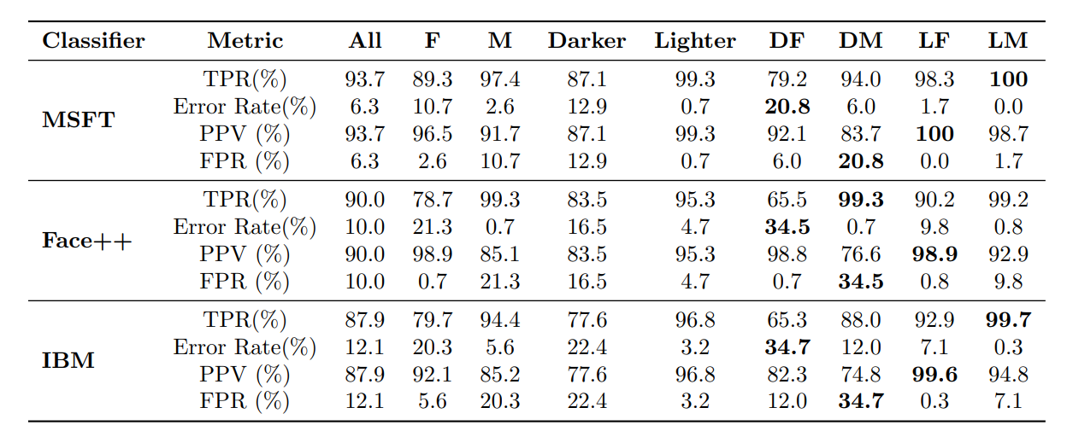
Increase Risk of Reliance on AI for Critical Decision Making
The autopilot system is the sole ‘pilot’ of the starship Avalon
Relating to real life: Modern AI systems can exhibit biases and affect certain groups disproportionately, for example races [1]. Without human intervention, there can be unintended consequences
[10]
[10]
Notes:
Script: Building off the previous slide, the autopilot system is the sole ‘pilot’ of the starship Avalon. This can raise ethical issues, such as what if the Passengers(Jim, Aurora, Gus) didn’t wake up, and due to that asteroid hitting the spaceship, the remaining 4000+ Passengers died, who would be responsible? Homestead Group or the Autopilot system? And what if Gus didn’t wake up, and Jim and Aurora were the only Passengers awake, would they be liable to the remaining hibernating passengers deaths because they tried to fix the issue, but were unsuccessful?
Relating to real-life, we see AI systems in present day exhibit biases and affect certain groups disproportionately in ways such as race. If everyone can direct their attention to Figure 10, we can see that the research from MIT and Microsoft found that women with darker skin had misclassification rates of 20.8%-34.7%, compared to error rates of 0.0%-0.8% for men with lighter skin using algorithms developed by Microsoft, Face++, and IBM. This form of bias can be harmful.
If we leave these AI systems as the sole decision maker, it would exhibit lots of bias and or errors that would harm many people. For instance, Relating back to the movie, the AI autopilot system was like “Oh yeah I can take on this asteroid” in the beginning of the movie and doesn't steer off course to avoid it. Meanwhile, a person pilot would use the AI system as a TOOL would see that asteroid is too big and potentially avoid it, solving all the issues in the movie potentially. There are more instances of AI bias or error causing potential harm to people(Arthur telling Aurora jim woke her up) (Arthur making jim go insane by saying he couldnt be there at teh bar?) BUT WE DONT HAVE ENOUGH TIME FOR THAT
The Columns represents the type of AI tech used, MSFT means Microsoft facial Technology, Face++ is Face++ Technology, IBM is IBM AI Tech for facial recognition.
TPR means True Positive Rate
FPR means False Positive Rate
PPV means Positive Predictive Value
Error rate means Error Rate
ALEX SLIDE

Slide 21
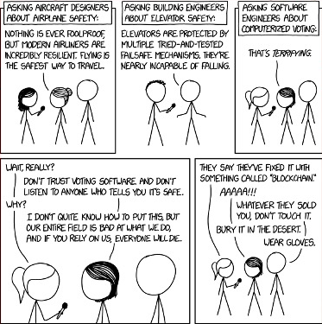
[20]
[20]
Notes:
Script: As we can see, this cartoon is a perfect example of all of what we talked about in this presentation. In this image all the engineers talked about it being nearly incapable or nothing ever being foolproof, which is something the Avalon did not do. They also put too much faith in a software system(the ships navigation) which let an Asteroid hit the fusion reactor on the ship. This cartoon explicitly makes it clear that good software engineers do not trust their own software.
ALEX SLIDE

Slide 22
References
1. MovieStillsDB, Passengers, https://i.pinimg.com/originals/91/28/63/91286398d55f8605e76e18bb9c30b0bd.jpg, (4/22/2024)
2. Flickr, Jennifer Lawrence Films, (Feb 7, 2017), https://live.staticflickr.com/371/31913260434_66b48b71ff_b.jpg
3. https://i.imgur.com/lmKAZzq.jpg (4/22/2024)
4. Columbia Pictures, Passengers, 12/21/16, (1:28:52)
5. Columbia Pictures, Passengers, 12/21/16, (timestamp)
6. Victor Ordonez, Lynn Hilton, Documents detail OceanGate's battle with whistleblower years before fatal Titan submersible implosion, (Feb 8, 2024), https://www.google.com/url?sa=i&url=https%3A%2F%2Fabcnews.go.com%2FUS%2Frun-risk-documents-detail-oceangates-battle-whistleblower-years%2Fstory%3Fid%3D106965104&psig=AOvVaw3IYChEFtIDc95X3rJpCQ20&ust=1713817399037000&source=images&cd=vfe&opi=89978449&ved=0CBIQjRxqFwoTCOirg7yR1IUDFQAAAAAdAAAAABAZ
7.https://i0.wp.com/timmaltin.com/wp-content/uploads/2019/05/broke-in-half.jpeg?fit=259%2C182&ssl=1 (4/12/2024)
8. Amazon, Logitech F710 Wireless Gaming Pad, Silver/Black (940-000117), https://m.media-amazon.com/images/I/51iefaxmqeL.jpg (4/22/2024)
9. Columbia Pictures, Passengers, 12/21/16, (timestamp)
10. Joy Buolamwini, Timnit Gebru, Gender Shades: Intersectional Accuracy Disparities in Commercial Gender Classification, (Jan 15, 2018), https://proceedings.mlr.press/v81/buolamwini18a/buolamwini18a.pdf (4/20/2024)
11. David Schaper, Boeing To Pay $2.5 Billion Settlement Over Deadly 737 Max Crashes, (Jan 8, 2021), https://www.npr.org/2021/01/08/954782512/boeing-to-pay-2-5-billion-settlement-over-deadly-737-max-crashes (4/23/2024)
12. Joseph Herkert, Jason Borenstein, Keith Miller, The Boeing 737 MAX: Lessons for Engineering Ethics, (Jul 10, 2020), https://www.ncbi.nlm.nih.gov/pmc/articles/PMC7351545/ (4/23/2024)
13. Richard Pallardy, Deepwater Horizon oil spill, (Apr 19, 2024), https://www.britannica.com/event/Deepwater-Horizon-oil-spill (4/23/2024)
Notes:
Script: And these are our references, any questions(Asking the class)?

Slide 23
References Cont
14. Marion Hart, The Ethical Lessons of Deepwater, (Dec 22, 2010), https://www.asme.org/topics-resources/content/the-ethical-lessons-of-deepwater (4/23/2024)
15. Columbia Pictures, Passengers, 12/21/16, (16:59)
16. Columbia Pictures, Passengers, 12/21/16, (1:40:11)
17.Columbia Pictures, Passengers, (12/21/16), https://m.media-amazon.com/images/S/pv-target-images/7ab5b49cde2d22538e819c6502d51aaf23cb2c659b509820af938b8864e1931f.jpg (4/23/2024)
18.Stephens Keanu, Titanic Lifeboat, https://www.stephensandkenau.com/wp-content/themes/modeShipYardTheme/timthumb.php?w=640&zc=1&q=100&src=https://www.stephensandkenau.com/wp-content/uploads/2015/10/19016-Titanic-Lifeboat.jpg&a=b (4/24/2024)
19. Linda Barnard, Passengers actor Michael Sheen talks about being a robo-bartender, (Dec 20, 2016), https://www.google.com/url?sa=i&url=https%3A%2F%2Fwww.thestar.com%2Fentertainment%2Fmovies%2Fpassengers-actor-michael-sheen-talks-about-being-a-robo-bartender%2Farticle_eaae723e-01a6-5e66-95a1-92f09866d2c0.html&psig=AOvVaw2mSUNvx6x9sdfII2duOAUi&ust=1714053306511000&source=images&cd=vfe&opi=89978449&ved=0CBIQjRxqFwoTCODK4KWA24UDFQAAAAAdAAAAABAE (4/24/2024)
20. xkcd, Voting Software, https://xkcd.com/2030/ (4/24/2024)
21. Columbia Pictures, Passengers, 12/21/16, (40:32)
22. Columbia Pictures, Passengers, 12/21/16, (1:13:31)
23. Columbia Pictures, Passengers, 12/21/16, (14:07)
24. Columbia Pictures, Passengers, 12/21/16, (9:26)
25. Columbia Pictures, Passengers, 12/21/16, (3:05)
26. Columbia Pictures, Passengers, 12/21/16, (1:29:43)
27. Steve Mackay, The Truth Behind Murphy’s Law, (Sep 27, 2016), https://www.eit.edu.au/the-truth-behind-murphys-law/ (4/20/2024)

Slide 24
References Cont
28. Columbia Pictures, Passengers, 12/21/16, (12:13)
29. Columbia Pictures, Passengers, 12/21/16, (26:29)
30. Columbia Pictures, Passengers, 12/21/16, (47:35)
31. Columbia Pictures, Passengers, 12/21/16, (1:04:12)
32. Columbia Pictures, Passengers, 12/21/16, (1:20:28)
33. Columbia Pictures, Passengers, 12/21/16, (1:29:03)
34. Columbia Pictures, Passengers, 12/21/16, (1:44:46)
35. Columbia Pictures, Passengers, 12/21/16, (2:40)
36. Columbia Pictures, Passengers, 12/21/16, (1:44:36)
37. Columbia Pictures, Passengers, 12/21/16, (1:38:08)
38. Columbia Pictures, Passengers, 12/21/16, (1:21:53)
39. Columbia Pictures, Passengers, 12/21/16, (38:20)
40. Bruno Frey, David Savage, Benno Torgler, Surviving the Titanic Disaster: Economic, Natural, and Social Determinants, (UC Berkeley, 2/1/19), https://escholarship.org/content/qt6h24b1vt/qt6h24b1vt.pdf?t=lnp2ro#:~:text=URL%3A%20https%3A%2F%2Fescholarship.org%2Fcontent%2Fqt6h24b1vt%2Fqt6h24b1vt.pdf%3Ft%3Dlnp2ro%0AVisible%3A%200%25%20 (4/25/24)
41. Was Titanic Unsinkable: Why Did People Think it Was?, (History on the Net, 2024), https://escholarship.org/content/qt6h24b1vt/qt6h24b1vt.pdf?t=lnp2ro#:~:text=URL%3A%20https%3A%2F%2Fescholarship.org%2Fcontent%2Fqt6h24b1vt%2Fqt6h24b1vt.pdf%3Ft%3Dlnp2ro%0AVisible%3A%200%25%20 (4/25/24)
42. Hayden Horner, Titan Submersible: What We Know About Its Design, Materials, and Its Implosion, (Engineering Institute of Technology, 8/15/23), https://www.eit.edu.au/titan-submersible-what-we-know-about-its-design-materials-and-its-implosion/ (4/25/24)
43. David Normansell, Lessons from the Boeing 737 MAX 8, (University of Virginia, Spring, 2020) libraetd.lib.virginia.edu/downloads/707958249?filename=Normansell_David_STS_research_paper.pdf (4/25/24)

Slide 25
Questions?

